Slide 1


Sarcasm Detection In Movie Reviews
Sarcasm, a form of verbal irony where the intended meaning is opposite to the literal words used, can obscure the true sentiment in movie reviews. Detecting sarcasm is crucial for accurately interpreting the emotional tone and overall opinion expressed in the reviews.
by Nikhitha Kurumaddali
GROUP 6
BATCH 02
Infosys Springboard internship
KK

Slide 2

Business Problem in Movie Reviews
Movie success hinges on audience feedback, making review analysis crucial for accurate ratings.
Websites like BookMyShow, IMDb, and Rotten Tomatoes are pivotal in collecting and presenting audience reviews.
However, some reviewers express their thoughts sarcastically, which can mislead traditional sentiment analysis models. This poses a challenge because sarcasm can mask the true sentiment of a review, leading to inaccurate analysis and potentially flawed ratings.
Positive Review: "Interesting, good filmmaking, surprisingly authentic." (Clear and positive)
Negative Review: "Dialogue is atrocious, acting phoned-in. Big disappointment." (Stronger wording emphasizes negativity)
Sarcastic Review (Difficult to Detect): "This movie was so bad, I'd rather gnaw on a golf ball." (Exaggerated statement hints at sarcasm)

Slide 3
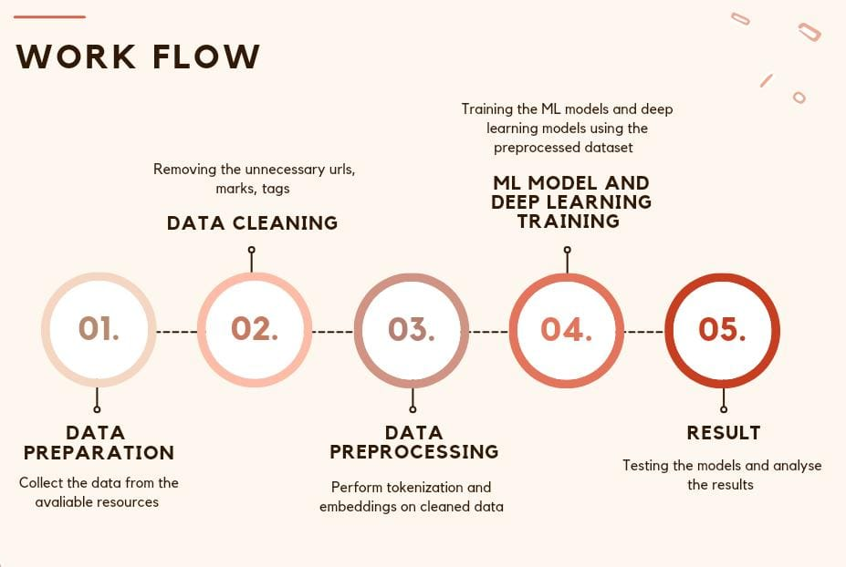
Proposed Solution
. To address the challenge of sarcasm detection, we need to develop and implement advanced Deep Learning models specifically designed to recognize and interpret sarcastic reviews.
To achieve this, we will follow the workflow outlined below to build the model:

Slide 4

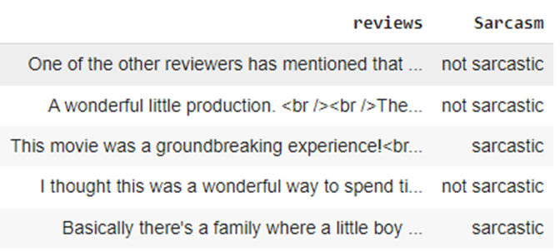
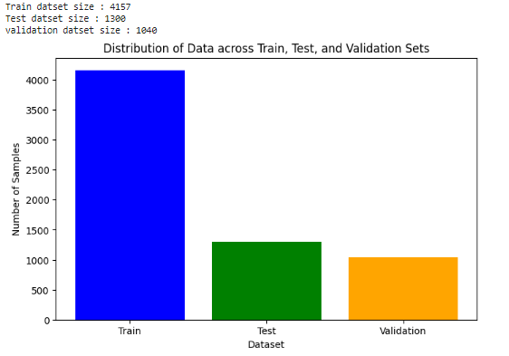
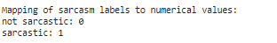
Data Preparation
1
Data Collection
We have gathered movie reviews from popular online platforms, such as IMDb, Rotten Tomatoes ensuring a diverse and representative dataset and labelling them as sarcastic and not sarcastic using online prediction models.
2
Data Exploration
We will perform an in-depth analysis of the dataset, examining the distribution of review lengths, sentiment, to gain a comprehensive understanding of the data.
3
Handle the Reviews
The dataset contained few duplicate reviews rows which are been removed . Also dropped unnecessary columns
4
Handle the Labels
The labels column contains few null values ,which are handled by removing the rows with null value label. The labels are encoded as '0' for Not Sarcastic and "1" for Sarcastic
5
Split the dataset
The dataset is split into train data , test data and validation data which are used for training and testing the ML and Deep Learning models

Slide 5

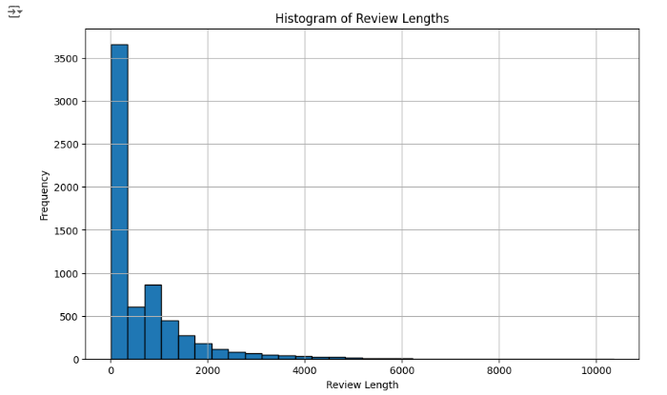
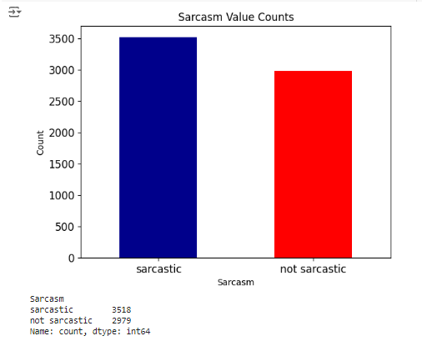
Insights on the Dataset
We have chosen the IMDB movie reviews dataset for this project from Kaggle, it contains a large volume of reviews, offering a diverse range of sentiments and writing styles.
The dataset contains around 7000 reviews labelled as Sarcastic and Not Sarcastic
No.of reviews that are Sarcastic : 3918 No.of reviews that are Not Sarcastic : 2979
The mean length of review in the dataset is 655 words
-
Review Length
Sarcasm Distribution

Slide 6

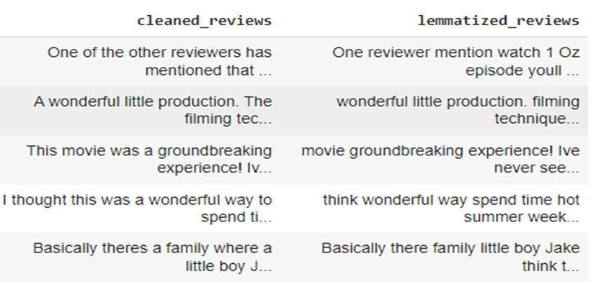


2) Data Cleaning
Text Normalization
We will standardize the review text by removing HTML tags, and eliminate unnecessary punctuation marks that do not contribute to sentiment or sarcasm detection. Removing any blank lines and excess white spaces
Stopword Removal
Common stopwords, such as "the," "a," and "is," will be removed to focus the model's attention on more informative words.
Lemmatization
Words will be reduced to their base forms (lemmas) to improve the model's understanding of semantic relationships and reduce vocabulary size.

Slide 7
3) Data Preprocessing
A) Tokenization
The review text will be broken down into individual words or tokens, which will serve as the basic units for the deep learning model.For our model we have used Keras Tokenizer
B) Vocabulary Building
A comprehensive vocabulary will be constructed, including the most frequent words in the dataset, to represent the diverse language used in movie reviews.
C) Embedding
The tokens will be transformed into numerical representations (embeddings) that capture the semantic relationships between words, enabling the model to understand the contextual meaning of the reviews.
D) Padding
To ensure all input sequences have the same length, the reviews will be padded with a special token, allowing the model to process batches of data efficiently. For our model we have used Keras Pad Sequences

Slide 8
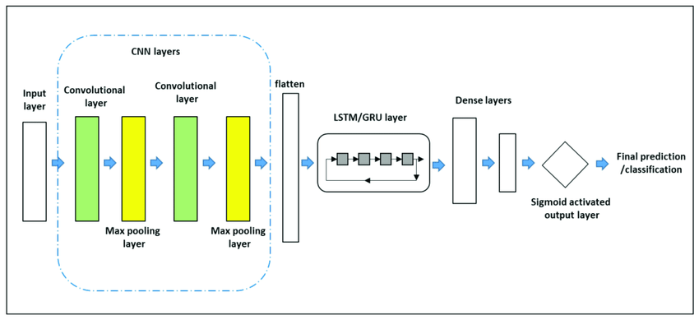
4) Model Training
Initially, we applied traditional ML models including logistic regression, Naive Bayes, decision tree, and Random Forest. After hyperparameter tuning, Random Forest emerged as the top performer due to its ability to handle complex relationships in the data.
Transitioning to deep learning, we explored architectures such as Neural Networks (NN), Convolutional Neural Networks (CNN), Long Short-Term Memory (LSTM), Gated Recurrent Unit (GRU), and BERT models.

Slide 9
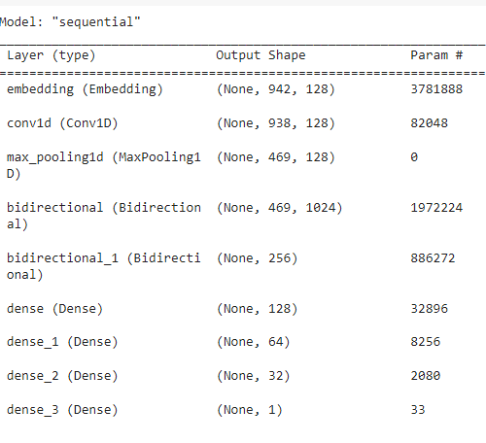
Why GRU Model for our dataset ?
GRUs are a type of recurrent neural network (RNN) that excel at modeling sequential data.
They maintain an internal state that captures dependencies across time steps, allowing them to learn context and patterns in text.
For sarcasm detection, this ability to capture sequential information is crucial because sarcasm often relies on subtle cues spread across multiple words or phrases.
Combining Convolutional Neural Networks (CNNs) and Gated Recurrent Units (GRUs) in a hybrid model can leverage their complementary strengths.
CNNs excel at capturing local patterns (e.g., n-grams), while GRUs handle sequential dependencies.
By combining these architectures, we can enhance sarcasm detection accuracy.

Slide 10
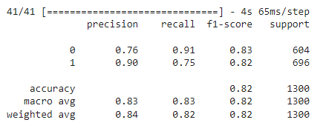
5 ) Results and Constraints
RESULTS
The hybrid CNN-GRU model demonstrates promising performance in sarcasm detection.
High precision (0.90) for class 1 (sarcasm) indicates accurate predictions when identifying sarcastic expressions.
Balanced recall (0.75) ensures that the model captures a significant portion of actual sarcasm instances.
The GRU-based model demonstrates strong performance, achieving an overall accuracy of 82% on the dataset, with balanced precision and recall across both classes.
CONSTRAINTS
The project does not include detecting sarcasm in non-English reviews.
It does not handle non-textual sarcasm such as in images, videos, or memes.
Real-time detection of sarcasm during review submission is also not covered.

Slide 11


Real-time Application and Future Scope
Real-time Deployment
Future Enhancements
This model can be applied to platforms like Rotten Tomatoes, which rely on user reviews to rate movies. By integrating sentiment analysis and our sarcasm detection model, we can enhance the accuracy of review ratings. This approach mitigates issues such as human bias, reviewer subjectivity, and language nuances, providing more reliable insights into audience sentiments.
Future enhancements could focus on distinguishing between sarcastic positive and sarcastic negative reviews. This advancement would further refine the movie review analysis system, offering deeper insights into audience reactions and improving decision-making for filmmakers and critics alike.
Conclusion
In conclusion, we have developed a sarcasm detection model for movie reviews using the IMDB dataset from Kaggle. The dataset underwent thorough cleaning and preprocessing. Initially, the preprocessed data was applied to a Random Forest ML model, achieving (mention precision and recall values). To enhance detection accuracy, we transitioned to a deep learning model, specifically the GRU model, which resulted in good performance. This approach effectively addresses ambiguity in movie review analysis caused by sarcastic expressions.

Slide 12


Thank You

